Slide 1
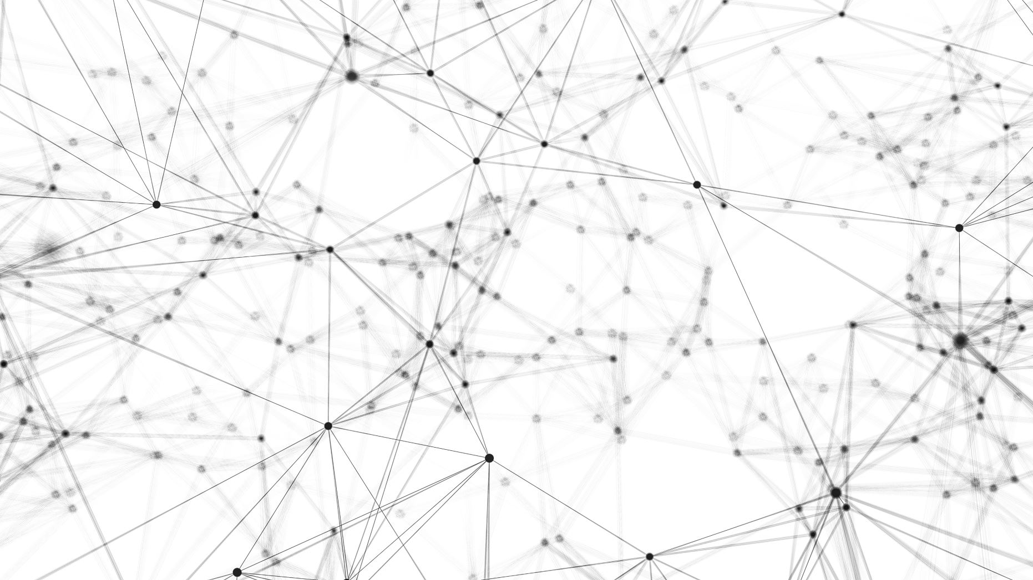
Standard internet protocols
Skye Nygaard
Luke Parkhurst
Debra Cooperman

Slide 2
Goals
Gain deep understanding of the underpinnings of the web: TCP, DNS, UDP, and network topologies and related algorithms
Demonstrate end-to-end scenario of web client querying DNS and communicating with a web server to retrieve and render pages
Three main components: 1) web client 2) DNS server environment 3) Web server environment

Slide 3
DNS
DNS Server hierarchy/topology—”Registrar” component sets everything up
Web Client communicates with DNS client that has a preconfigured local DNS server
Uses UDP to transmit DNS query/response packets between DNS servers. Support of both recursive and iterative querying

Slide 4
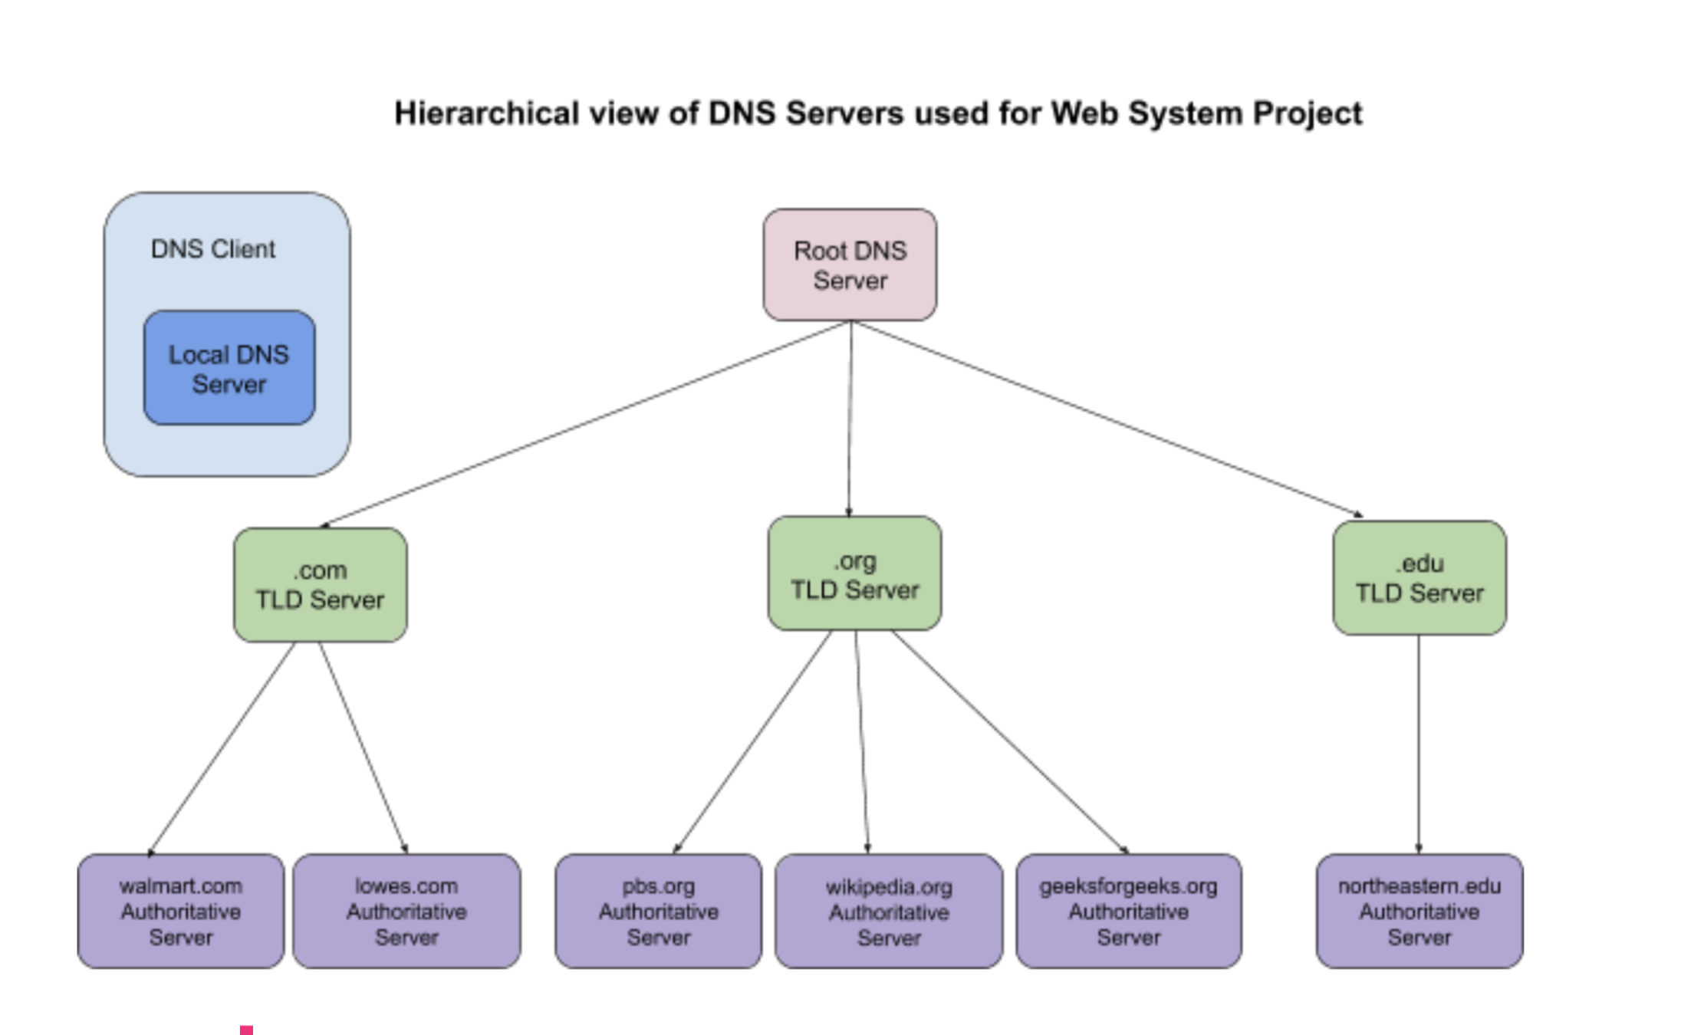

Slide 5
Web Server
Receives client’s request, after client is routed to the server via the DNS server
Proceeds to parse the request header for information on the request
Uses the information from the request header to grab requested file
Sends back the file with any special formats requested

Slide 6
Web Server Path
Echo Get Header
Passes file path
Web Server
Database
Pulls requested file
Parses URL
Parses Request
Web Server Handler
File Requested
Client Request

Slide 7
Multi Threaded Applications
The servers need to be able to handle multiple clients at once
This is solved by creating a multithreaded server that splits in new threads
Helps to allow multiple clients to give multiple calls

Slide 8
Emulation Goals
Attempt to emulate a network of 6 web servers, 3 clients, 1 DNS server
Show the client VM reaching the webserver VM through DNS server
Speak between two “ISP’s” to show network routing

Slide 9
Client
User interaction
HTML parsing and Display
TCP with server for file transmission

Slide 10
Console Commands
Header=
Size:
Language:
Save=path
Path creation, go iterate through folder structure
Offline for future use

Slide 11
HTML Parser
Pattern link = Pattern.compile("(?<=<link).+?(?<=href=\")(\\./.+?)(?=\")");
Pattern script = Pattern.compile("(?<=<script).+?(?<=src=\")(\\./.+?)(?=\")");
Pattern img = Pattern.compile("(?<=<img).+?(?<=src=\")(\\./.+?)(?=\")");

Slide 12
Browser - Rendering Engine
Desktop.getDesktop().open(new File(filePath));
Default program for file type

Slide 13
Challenges
Simulating the network!
Multithreading
Dealing with non-HTML web content
Complicated DNS headers, DNS querying and caching

Slide 14
Future work
Performance tuning and robustness
Support for more content
Full network simulation with real IP addresses, etc.

